Slide 1
3. Robot Control
3.1 Fundamentals
3.2 Single-joint Control
3.3 Computed Torque Control
3.4 Lyapunov Stability Analysis
3.5 Adaptive Control
- 0 -

Slide 2
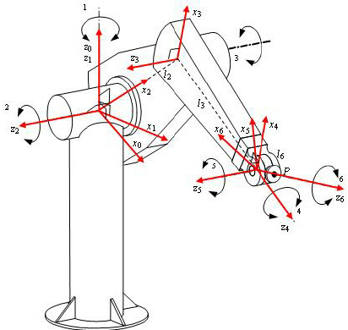
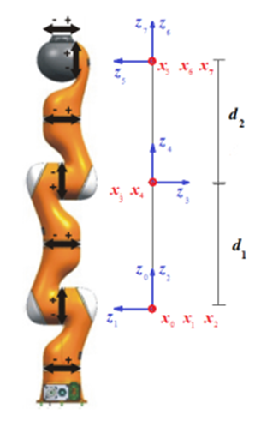
3.1 Fundamentals
PUMA560 with 6 DOF
KUKA IIWA with 7 DOF
Kinematics
Tedious
Dynamics
Complicated
- 1 -

Slide 3
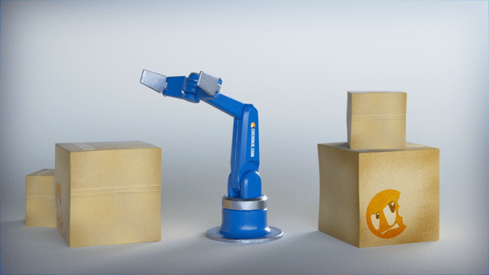
3.1 Fundamentals
Our ultimate goal is to control the system in accordance with certain Pre-specified Performance Criterion.
- 2 -

Slide 4
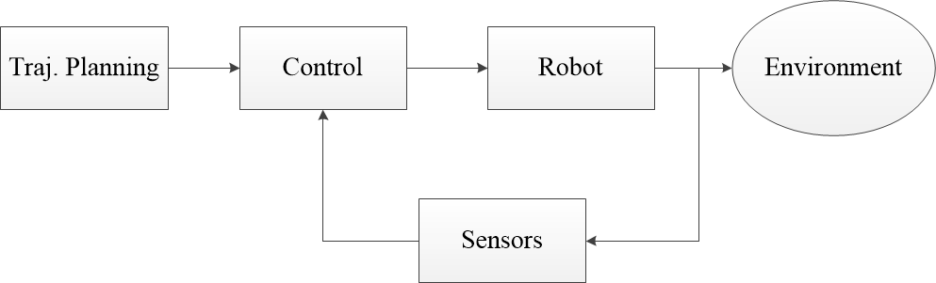
3.1 Fundamentals
Figure 3.1 Basic Blocks (Modules) of Robotic System
- 3 -

Slide 5
3.1 Fundamentals
3.1.1 Classification of Robot Control Scheme
Each joint has a controller and only local information is known
Decentralized Control
I. Control
II. Task
III. Technique
IV. Others
Centralized Control
Point-to-Point Control
Motion Control
Continuous Trajectory Control
Force Control
Linear Control
Nonlinear Control
Open-Loop
Suitable for pneumatic pick and place operations
Close-Loop
- 4 -

Slide 6
3.1 Fundamentals
Robot
Traj.
Generator
Controller
Figure 3.2 Functional Block (Module) Diagram of a Robot Control System
- 5 -

Slide 7
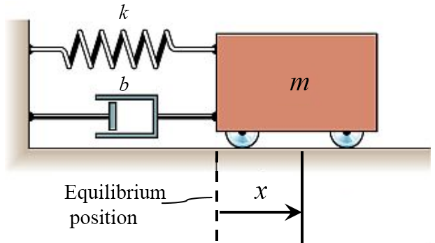
3.1 Fundamentals
3.1.2 Stability of 2nd Order Linear Systems
The most basic criterion in designing a control system is to
ensure that the resulting closed-loop system is stable.
Consider the mass spring system
i.e.,
Fig. 3 Mass Spring System
- 6 -

Slide 8
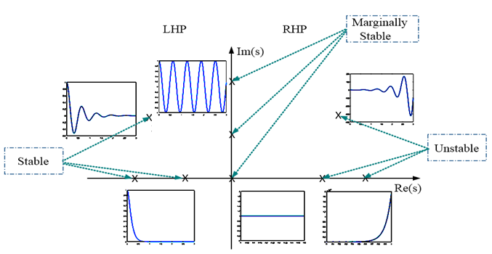
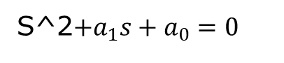
3.1 Fundamentals
Under the assumption of zero initial conditions, we have the characteristic equation:
The solutions (poles) of the system are given by
S^2$+a_{1}s+a_{0}=0$
When , we have the fastest possible non-oscillatory response. This response is called critically damped.
- 7 -

Slide 9
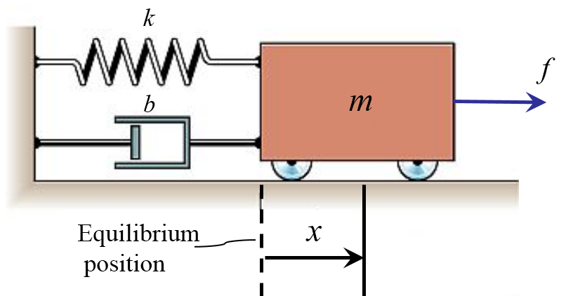
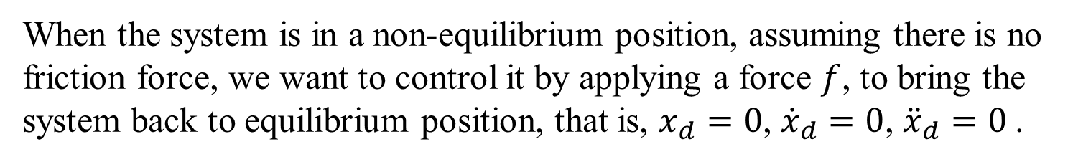
3.1 Fundamentals
3.1.3 Control of 2nd Order Forced Systems
Consider the forced mass-spring system, we have
When the system is in a non-equilibrium position, assuming there is no friction force, we want to control it by applying a force $f$, to bring the system back to equilibrium position, that is, $x_{d}=0$, ${\dot{x}}_{d}=0$, ${\ddot{x}}_{d}=0$.
- 8 -

Slide 10
3.1 Fundamentals
Supposing that , , are measurable, we can construct a well-known PD control as
for position regulation.
The closed-loop dynamics is
i.e.,
or
- 9 -

Slide 11
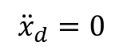
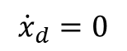
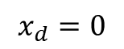
3.1 Fundamentals
By choosing our control gains, and , we can make the closed-loop system to appear to have a desired 2nd order system behavior.
$${\ddot{x}}_{d}=0$$
+
+
+
$${\dot{x}}_{d}=0$$
+
-
Equilibrium
position
$$x_{d}=0$$
+
-
- 10 -

Slide 12
3.1 Fundamentals
3.1.4 Control Law Partitioning
The control is partitioned into two portions:
1) a Model-based portion
2) a Servo portion
For the open-loop equation of motion
we wish to use the model-based portion to transform the system to a unit mass system for simple Servo Control Design.
- 11 -

Slide 13
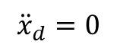
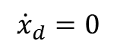
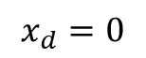
3.1 Fundamentals
u is a new input for the transformed system
Model based portion:
Choosing
we have the simple unit
mass system
for which a simple PID control is enough.
$${\ddot{x}}_{d}=0$$
+
+
+
$${\dot{x}}_{d}=0$$
+
-
$$x_{d}=0$$
+
-
- 12 -

Slide 14
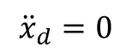
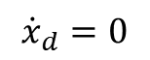
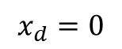
3.1 Fundamentals
Suppose
We have the error equation
The selection of control gains is simple and independent of system parameters.
For critical damping,
$${\ddot{x}}_{d}=0$$
+
+
+
$${\dot{x}}_{d}=0$$
+
-
$$x_{d}=0$$
+
-
- 13 -

Slide 15
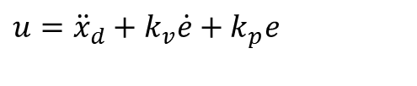
3.1 Fundamentals
3.1.5 Trajectory-following Control
Apart from positional regulation, we are also interested in tracking control. Assume the desired trajectory is specified by
, , at all times t.
Define the tracking error:
The corresponding tracking control law is
$$u={\ddot{x}}_{d}+k_{v}\dot{e}+k_{p}e$$
(3.1.1)
The closed-loop error equation is
(3.1.2)
We can choose the coefficients for different control performance.
- 14 -

Slide 16
3.1 Fundamentals
- 15 -

Slide 17
3.1 Fundamentals
3.1.6 Disturbance Rejection
Concepts:
Bounded-input, Bounded-output (BIBO) stability:
Steady-state error:
The effects of integral control:
then the error equation is
The integral term is added to reject steady state errors in the presence of constant disturbance.
- 16 -

Slide 18
3.1 Fundamentals
3.1.7 Stability Analysis:
If the position of -p1 is much further to left on half plane than the roots of
then the second subpart of the system will dominate dynamics.
- 17 -

